Slide 1
More about DB queries
Arafat Hassan

Slide 2
Eloquent Model methods

Slide 3
Eloquent Model Methods
In the last class we made a model Product. We have used Product::all(), Product::create(), and Product::destroy() methods
There are more methods to help you with database queries.
The first one is Model::where(columnName, value)
Product::where(‘name’, ‘iPhone’) returns an instance of query builder (an object of type Illuminate\Database\Eloquent\Builder)
Calling ->get() on Builder returns a collection. In this case, it returns a collection of products whose name is equal to iPhone (case insensitive).

Slide 4
Eloquent Model Methods
Collections are wrapper classes of php arrays. They are just like arrays, except that they provide you extra methods to make things easier.
I encourage you to check more about collections from laravel documentation: Collections
You can iterate over them like arrays and access individual element like arrays too.

Slide 5
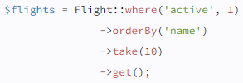
Query Builder
You can chain more queries on a Builder to keep filtering the results. Just call ->get() when done to get a collection.
Here Flight is a model. We know that each model is associated with one table. So instead of Flight::where… we could have done DB::table(‘tableName’)->where… You will get the same result.
Just find the table name from the migration and/or phpmyadmin

Slide 6
Query Builder
There are many more querybuilder methods available. Let's have a look at some of them.
Remember that what works with DB:table(‘name’) will also work the same way with Model class
For example, you can replace DB:table(‘name’)->query1()->query2()… with ModelName->query1()->query2()
Of course the ModelName should be the model related to that particular table

Slide 7
Query Builder: Select
Product::select('name')->get(); // only ‘name’ column
Product::all(); // returns all rows
DB::table('users')
->select('name', 'email as user_email')
->get();
DB::table('users')->distinct()->get(); // returns distinct results

Slide 8
Query Builder: Select
If you already have a query builder instance and you wish to add a column to its existing select clause, you may use the addSelect method:
$query = DB::table('users')->select('name');
$users = $query->addSelect('age')->get();
You don’t have to worry about sanitizing the input here, because query builder does that for you. So you can feel safe about SQL injection attacks.

Slide 9
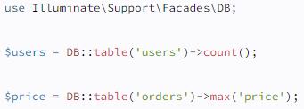
Query Builder: Aggregates
The query builder also provides a variety of methods for retrieving aggregate values like count, max, min, avg, and sum. You may call any of these methods after constructing your query:

Slide 10

Query Builder: Aggregates
Of course, you may combine these methods with other clauses to fine-tune how your aggregate value is calculated:

Slide 11
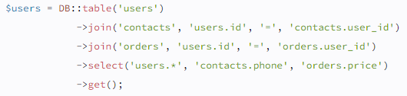
Query Builder: Join
To perform a basic "inner join", you may use the join method on a query builder instance.
The first argument passed to the join method is the name of the table you need to join to, while the remaining arguments specify the column constraints for the join. You may even join multiple tables in a single query:

Slide 12
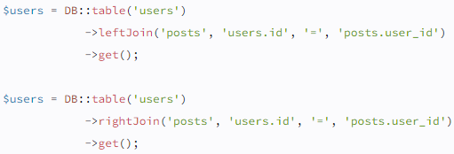
Query Builder: Join
If you would like to perform a "left join" or "right join" instead of an "inner join", use the leftJoin or rightJoin methods. These methods have the same signature as the join method:

Slide 13

Query Builder: Join
You may use the crossJoin method to perform a "cross join". Cross joins generate a cartesian product between the first table and the joined table:
You can union two queries using the qunion method -
$third = $first->union($second);
… Where $first and $second are instances of query builder.

Slide 14

Query Builder: Where
The basic use is pretty self explanatory -
For convenience, if you want to verify that a column is = to a given value, you may pass the value as the second argument to the where method. Laravel will assume you would like to use the = operator:

Slide 15
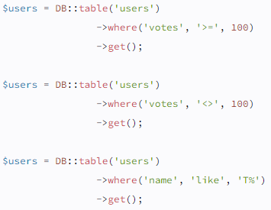
Query Builder: Where
you may use any operator that is supported by your database system:

Slide 16

Query Builder: Where
You may also pass an array of conditions to the where function. Each element of the array should be an array containing the three arguments typically passed to the where method:
Chaining where methods give the same effect as using “and”

Slide 17
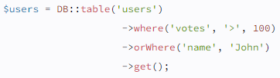
Query Builder: Where
For “or”, we have orWhere()

Slide 18
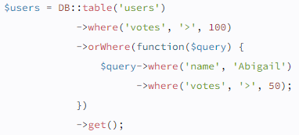
Query Builder: Where
If you need to group an "or" condition within parentheses, you may pass a closure as the first argument to the orWhere method:
select * from users where votes > 100 or (name = 'Abigail' and votes > 50)

Slide 19
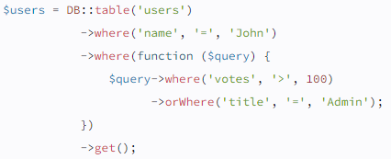
Query Builder: Where
select * from users where name = 'John' and (votes > 100 or title = 'Admin')

Slide 20


Query Builder: Where
The whereBetween method verifies that a column's value is between two values:
The whereNotBetween method verifies that a column's value lies outside of two values:

Slide 21


Query Builder: Where
The whereIn method verifies that a given column's value is contained within the given array:
The whereNotIn method verifies that the given column's value is not contained in the given array:

Slide 22


Query Builder: Where
The whereNull method verifies that the value of the given column is NULL:
The whereNotNull method verifies that the column's value is not NULL:

Slide 23
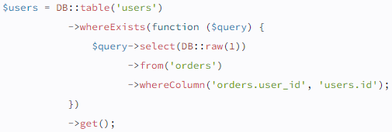
Query Builder: Where
The whereExists method allows you to write "where exists" SQL clauses. The whereExists method accepts a closure which will receive a query builder instance, allowing you to define the query that should be placed inside of the "exists" clause:

Slide 24
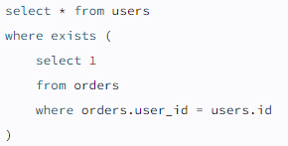
Query Builder: Where
The query above will produce the following SQL:

Slide 25

Query Builder: Order by
The orderBy method allows you to sort the results of the query by a given column.
The first argument accepted by the orderBy method should be the column you wish to sort by, while the second argument determines the direction of the sort and may be either asc or desc:

Slide 26
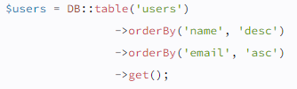
Query Builder: Order by
To sort by multiple columns, you may simply invoke orderBy as many times as necessary:
The latest and oldest methods allow you to easily order results by date. By default, the result will be ordered by the table's created_at column.
$user = DB::table('users') ->latest()->first();

Slide 27


Query Builder: Order by
The inRandomOrder method may be used to sort the query results randomly. For example, you may use this method to fetch a random user:
The reorder method removes all of the "order by" clauses that have previously been applied to the query:

Slide 28
Query Builder: Limit and offset
You may use the skip and take methods to limit the number of results returned from the query or to skip a given number of results in the query:
Alternatively, you may use the limit and offset methods. These methods are functionally equivalent to the take and skip methods, respectively:
$users = DB::table('users')->offset(10) ->limit(5)->get();

Slide 29
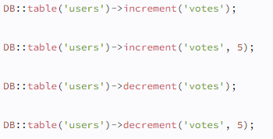
Query Builder: Increment and decrement
Easy stuff -

Slide 30
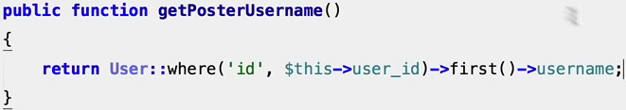
A practical example
So let's consider a database having articles and users. Each user can write multiple articles, but each article can only be written by one user.
User table has columns id, first name, last name, date of birth.
Article table has columns user_id (foreign key), title, body
So to get the author of a particular article, you can implement this method in Article model class -

Slide 31
Primary and foreign keys in schema builder

Slide 32
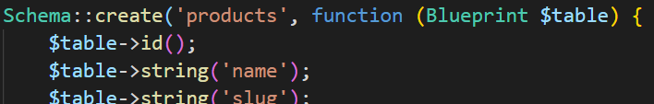
Keys in Schema Builder
Take a glance at the table schema in the last class
id() is automatically set as primary key and auto incrementing.
In order to set this as foreign key in another table, we do this (in migration file of the other table) ->
$table->integer('product_id')->unsigned();
$table->foreign('product_id')->references('id')->on(‘products’);

Slide 33
Keys in Schema Builder
In this example, we are stating that the product_id column references the id column on the products table.
Make sure to create the foreign key column first!
You can checkout more about schema builder in laravel from here - Schema Builder

Slide 34
Challenges

Slide 35
Challenges
Your task is to design an api for a banking system, which maintains information about customers and their accounts. For this, use the user model already present in Models folder.
The scenario -
Each customer has a name, a permanent address, and a social security number.
Each customer can have multiple phone numbers, and the same phone number may be shared by multiple customers.
A customer can own multiple accounts, but each account is owned by a single customer.

Slide 36
Challenges
The scenario (continued) -
Each account has an account number, a type (such as saving, checking, etc), and a balance.
The bank issues an account statement for each account and mails it to its account owner every month. As time goes on, there will be multiple statements of the same account.
Each statement has an issued date and a statement ID. All the statements of the same account have different statement IDs, but two different accounts could have statements with the same statement ID. For example, it is possible that account A has a statement with ID ‘123’, while account B has another statement with the same ID ‘123’.

Slide 37
Challenges
Make an API that allows -
Customers to open an account
To see information about their existing accounts
To edit information of one of their accounts
To see their personal information
To edit their personal information (adding or removing phone numbers, changing permanent addresses. No change to name and SSN)

Slide 38
Challenges
Make an API that allows (continued) -
Issuing a new statement.
See all statements of a particular account and a particular user.
If you need additional assumptions to complete your diagram, please state your assumptions here as well.
You might find it helpful to plan the ER diagram first, then translating to a set of relations before you start coding. This is not mandatory but is highly recommended. Without sufficient planning, you are very likely to get stuck and may have to start over.
Apart from that, make sure you plan your routes and controllers too.

Slide 39
Thank you!

